Slide 1

Welcome to Idea Store Learning
2026-27

Slide 2
Today we will talk about…
Your course
Learning and attendance
Staying safe and getting help
Support and your next steps

Slide 3
Welcome to your course
Tutor:
Course title & code:
Course dates:
Tutor contact details:
Wi-Fi name: Ideastore
Wi-Fi password: ideastore2486

Slide 4





What you need for class
Please bring these to every class
Put your handouts in your folder and take them home
Your tutor will tell you if you need anything else
a smart phone
(if you have one)
a water bottle
A pen
A folder

Slide 5
Your learning goals/ learning plan
Your learning plan is about you and your learning
You will think about what you want to learn
You will decide a personal target
Your tutor will talk to you about your progress
At the end of your course, your tutor will help you think about your next step.
We call this your ILP.

Slide 6
Attendance
Come to every class
Arrive on time
If you cannot come to class, tell your tutor
If you miss too many classes, you may lose your place
Try not to make appointments during class time
Good attendance means good progress

Slide 7
Working together
Be kind and respectful
Listen when other people are speaking
Work with different people
Ask for help when you need it
Complete your classwork and homework
Keep your phone on silent
Bring your folder, homework and pen to class

Slide 8
Gifts
At Idea Store, we appreciate learners offering gifts to teachers.
However, teachers do not accept presents from learners.
This is to ensure fairness for everyone.
Your progress and hard work are the best gift we can receive!
Thank you for your understanding.

Slide 9
What you can expect from us
We will treat you fairly and with respect
We will give you good teaching and support
We will help you to learn and make progress
We will help you feel safe
We will listen if you have a problem
We will help you think about your next steps

Slide 10
If you have a problem
Please tell us. We want to help
You can talk to your tutor
If you cannot talk to your tutor, speak to a manager:
ESOL: Victoria.holmes@towerhamlets.gov.uk
English, Maths & Outreach: Nikki.Chatha@towerhamlets.gov.uk
Digital & employability: Nicholas.beer@towerhamlets.gov.uk
Or
Contact: learnerservices@towerhamlets.gov.uk

Slide 11
Health and Safety

Slide 12
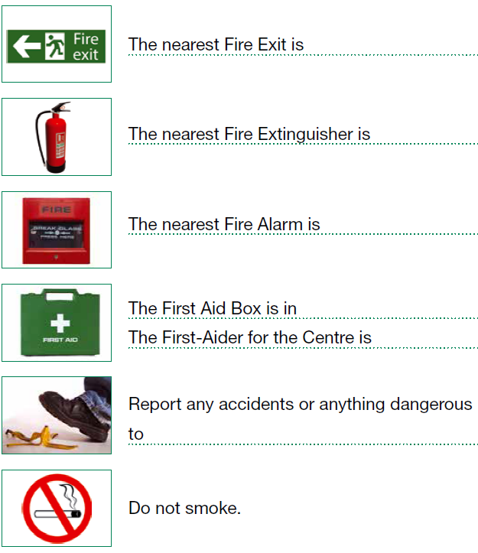
What to do in a fire or emergency
 | The nearest fire exit is
 | The nearest fire alarm is
 | The first aid box is
 | The first aider is
 | Report any accidents or anything dangerous to
 | Do not smoke

Slide 13
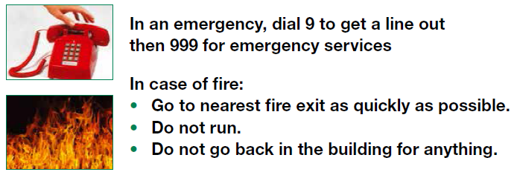
Health and Safety
In an emergency, dial 999 for the emergency services
If there is a fire:
Take your belongings from under your table
Go to the nearest fire exit as quickly as possible
Do not run
Go to the fire assembly point
Wait for your teacher to call your name
Wait for your teacher to tell you to leave the area

Slide 14
Safeguarding

Slide 15
Safeguarding - keeping you safe
Safeguarding means keeping people safe from harm
You can talk to us if you are worried about yourself or someone else

Slide 16




Harm can include…
  Physical abuse
Sexual abuse
Emotional abuse
Financial abuse
Neglect
Discrimination
Modern day slavery
Radicalisation (Prevent)

Slide 17
What should you do if you are worried?
Tell your tutor or another member of staff
You can speak to us privately
You can also contact the safeguarding team
We will listen and help you

Slide 18
Safeguarding Discussion
What kinds of problems might someone need help with?
Safeguarding - Quiz (wordwall.net)

Slide 19
Safeguarding contacts
If you are in danger or are worried about another learner, tell your tutor or contact the Idea Store Learning Safeguarding Team
ISL.Safeguarding@towerhamlets.gov.uk
020 7364 1080
The Idea Store Learning Safeguarding Team
Faruk Miah – Designated Safeguarding Lead
Ian Wollington– Deputy Designated Safeguarding Lead
Victoria Holmes – Safeguarding Support Officer
Nikki Chatha - Safeguarding Support Officer

Slide 20
Learning Online

Slide 21
Online Safety
Do not share your personal information
Do not share another learner’s information
Only send messages, pictures or files about your course
Be respectful online
Tutors reply during working hours

Slide 22

What do we use for online learning?
Your tutor may use Google classroom for classwork and homework
You do not have to join if you do not want to.
Your tutor will make another plan with you
Please check your classwork and messages
Tutors may not reply immediately

Slide 23
Online Class Rules
Try and find a quiet place to join your class
One person to speak at a time
Use the mute control if it is noisy in your home
Listen to the teacher and others in your class
If you don’t want to show your home, you can change the background.
Be patient! Sometimes the internet connection can be slow!

Slide 24
WhatsApp
Your teacher may use WhatsApp to send course messages
Save your tutor's mobile number
Please read messages from your tutor
WhatsApp is only for course information

Slide 25

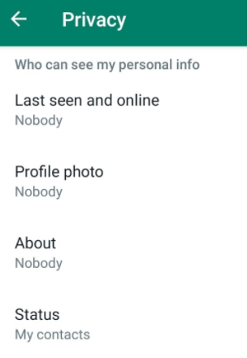
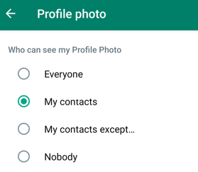
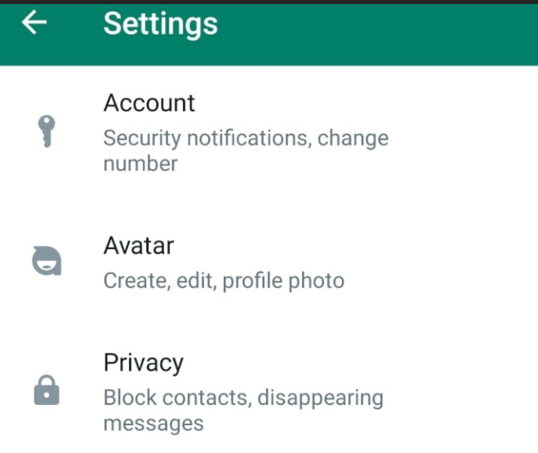
WhatsApp Privacy Settings
1. Click on the 3 dots and open settings
3. Click on profile photo
4. Decide who you want to see your profile photo:
2. Click on privacy

Slide 26
Extra Support

Slide 27
Learner Support & Advice
Do you need extra help with learning?
Tell your tutor if you need extra help
We will talk to you about what support may be available
You can talk to us privately

Slide 28
Oyster Card Support
(For exam classes only)
This is for exam classes only
Ask your tutor if you may be eligible
It pays 50% of your travel costs
It is for bus travel to and from class
Eligibility: UC & depending on postcode

Slide 29
Local support services
If you need help with any of the following issues:
Money – benefits, debt and Council Tax
Housing
Health and wellbeing
Safety
Work and digital skills
Legal advice
Talk to your teacher if you need help.

Slide 30
Your next steps

Slide 31
What happens after your course?
Your tutor will support you during your course
Your tutor will tell you how you are progressing
Your tutor will give you feedback on your classwork and homework
Near the end of the course, your tutor will talk to you about your next steps
You may be able to move on to another Idea Store learning course
You cannot usually repeat the same course in the same year
If another provider is better for you, your tutor will tell you

Slide 32
ESOL PRE ENTRY LEVEL
ESOL first steps: learning in the classroom
ESOL ENTRY 1 LEVEL
ESOL everyday English: me and my interests
ESOL ENTRY 2 LEVEL
ESOL everyday English: managing everyday life and money
ESOL first steps: reading, writing and communication
ESOL first steps: my story, where I’m from
ESOL first steps: my story, living and studying in the UK
ESOL everyday English: my area and local services
ESOL everyday English: using English in the community
ESOL reading qualification
ESOL writing qualification
ESOL everyday English: life in the community
ESOL everyday English: communication for work and everyday situations
ESOL speaking and listening qualification
ESOL reading qualification
ESOL writing qualification
ESOL ENTRY 3 LEVEL
ESOL speaking with confidence for women
ESOL communication for work and everyday situations
ESOL reading qualification
ESOL writing qualification
ESOL everyday English: learning online and next steps
ESOL speaking and listening qualification
ESOL: communication for work and everyday situations (entry 3 Ascentis Skills for Employment)
ESOL speaking and listening qualification
ESOL communication for work and everyday situations (entry 2) Ascentis Skills for Employment)
ESOL LEVEL 1
ESOL everyday English: expressing ideas and opinions clearly
ESOL LEVEL 2
ESOL speaking and listening qualification
IELTS preparation
ESOL everyday English: using English for life, work and the community
Communication for Work and Everyday Situations
ESOL reading qualification
ESOL writing qualification
ESOL: communication for work and everyday situations (level 1 Ascentis Skills for Employment)
ESOL speaking and listening qualification
MOVING TO FUNCTIONAL SKILLS
English writing skills: building clear and accurate sentences
English grammar skills: using tenses and sentence structures confidently
English writing skills: Improving spelling, punctuation and proofreading
English writing skills: developing clear and structured writing
Bridging from ESOL to Functional Skills: reading with confidence
Bridging from ESOL to Functional Skills: write with confidence
Bridging from ESOL to Functional Skills: English in the workplace

Slide 33
EMPLOYABILITY
Work experience: ESOL for early education and childcare part 1 (ESOL level 1)
Work experience: ESOL for early education and childcare part 2 (ESOL level 1)
ESOL for health and care: learning about the sector (ESOL level 1)
ESOL for health and care: preparing for the qualification (ESOL level 1)
Work experience: becoming an ESOL teaching assistant (level 1)
DIGITAL
First steps in digital skills
Becoming confident in digital skills
Prepare for your Essential Digital Skills qualification (entry 3)
Essential Digital Skills qualification (entry 3)
Your voice: write and design the student newsletter
Prepare for your Essential Digital Skills qualification (level 1)
Work experience: starting a volunteering role (level 1)
Work experience: volunteer at a local food charity (level 1)
Prepare for British Sign Language
British Sign Language Award (level1)
Essential Digital Skills qualification (level 1)
Start or grow your business with digital marketing (level1-2)
Word, Excel, PowerPoint for work and life

Slide 34
ENGLISH
MATHS
Becoming confident with numbers - mental maths (Entry 3)
English writing skills: sentence, spelling, and punctuation (level 2)
Vocational skills: speaking with confidence at work (level 2)
English grammar skills made easy - express yourself with confidence (level 2)
Vocational skills: professional communication skills for care and support roles (level 2)
Vocational skills: professional writing skills - emails, letters and reports (level 2)
Vocational skills: speaking with confidence at work (level 2)
Preparing for Functional Skills English (level 1 & 2)
Getting ready for Functional Skills English (level 1 & 2)
Functional Skills English qualification (level 1 & 2)
Getting ready for Functional Skills Maths (level 1 & 2)
Functional Skills Maths qualification (level 1 & 2)
Preparing for Functional Skills Maths (level 1 & 2)
Becoming confident with numbers - shapes and measurements (Entry 3)
Maths for work and life (entry 3)
Becoming confident with numbers: in health and care (entry 3)
Becoming confident with numbers: handling information and data (entry 3)

